Slide 1
Data Warehouse ——A Multi-dimensional data model——
徐华
清华大学 计算机系 智能技术与系统国家重点实验室
xuhua@tsinghua.edu.cn

Slide 2
Data Model
Review the basic concepts of database
What is a data warehouse?
A multi-dimensional data model
Data warehouse architecture
Data warehouse implementation
From data warehousing to data mining

Slide 3
Data Cube (1)
A data warehouse is based on a multidimensional data model which views data in the form of a data cube
A data cube, such as sales, allows data to be modeled and viewed in multiple dimensions
Dimension tables（维表）, such as item (item_name, brand, type), or time(day, week, month, quarter, year)
Fact table （事实表） contains measures (such as dollars_sold) and keys to each of the related dimension tables
In data warehousing literature, an n-D base cube is called a base cuboid(基本方体). The top most 0-D cuboid, which holds the highest-level of summarization, is called the apex cuboid(顶端方体). The lattice of cuboids forms a data cube.

Slide 4
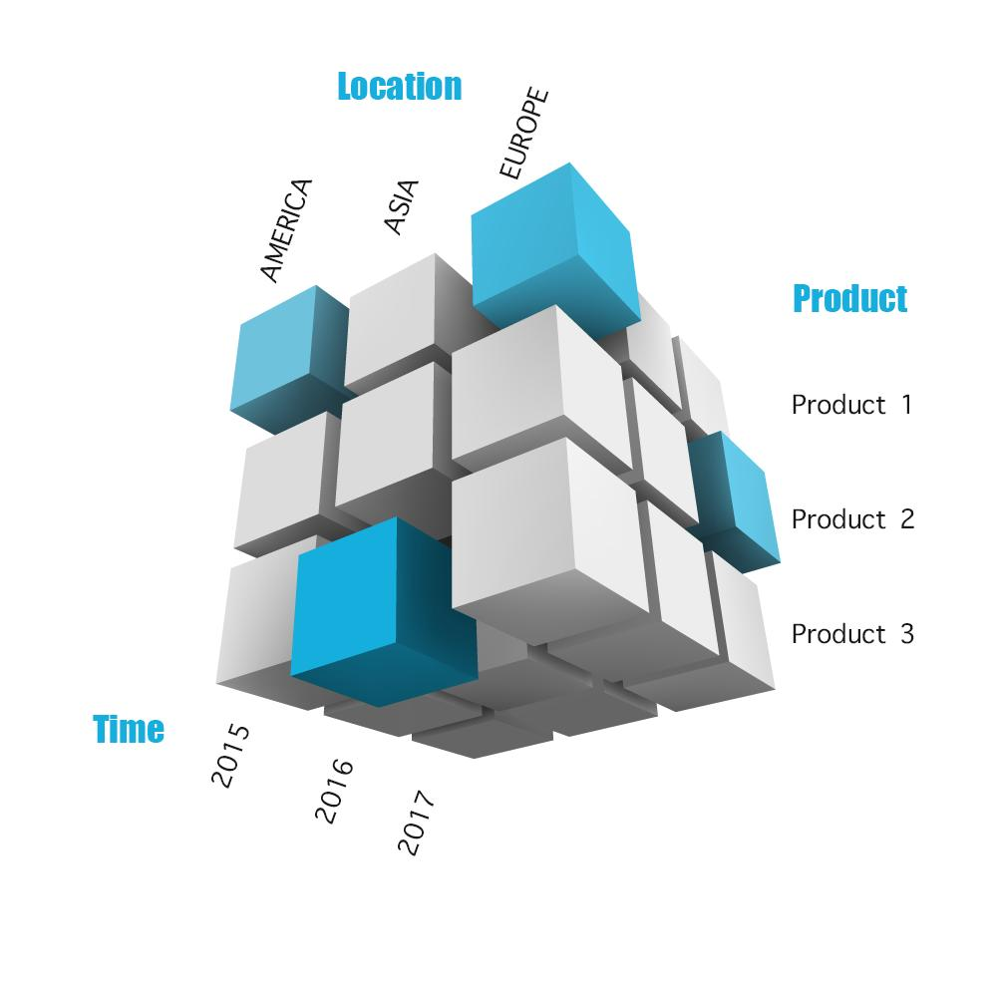
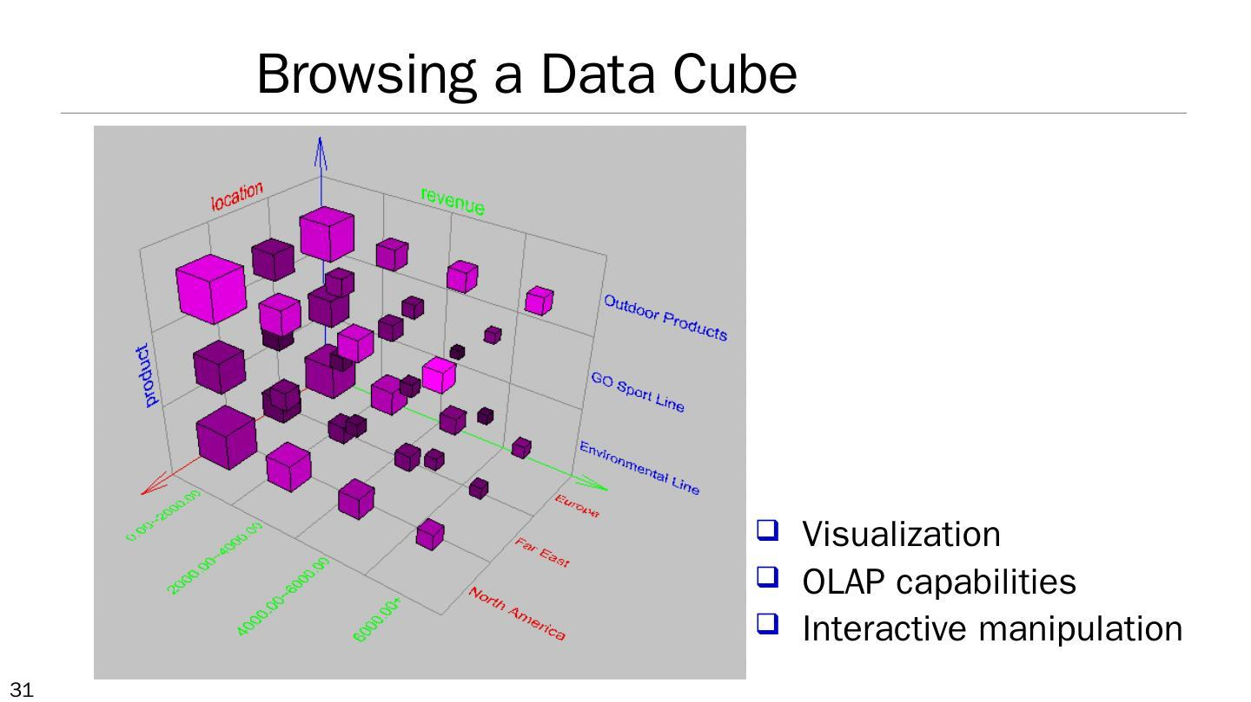
Data Cube (2)

Slide 5
Data Cube (3)
Dimension and Dimension table
Dimension: is the perspectives or entities with respect to which an organization wants to keep records.
Dimension table: is a set of properties to further describes a dimension.
Each dimension may be associated with a dimension table.
Time, item, location, provider
Fact and fact table
Fact: the measure of a theme
Fact table: the representation of the fact. It contains the names of the facts, keys to each of the related dimension tables. Facts are numerical, sales amount

Slide 6
Data Cube (4)
Dimension number of data cube
The number of dimensions to be viewed.
Sales（item time location dollars_sold ）
Base cuboid: the cube which contains all dimensions that can be viewed in data warehousing.
Apex cuboid: the cube which contain no dimension.
Data Cube: is the all cuboids in a multi dimensional data model.

Slide 7
Data Cube — One Example(1)
ALLElectronics sales
dimension：time，item，location，brand
dimension table：
time(time_key day day_of_week month quarter year)
item(item_key item_name brand type supplier_key)
fact table：(time_key item_key brand_key location_key dollars_sold units_sold)

Slide 8
Data Cube — One Example(2)
2-dimension data cube：
location＝”Vancouver”
item(type)
Time(quarter)
computer
security
entertainment
Q1 605 825 400
Q2 680 920 512
Q3 781 1026 501
Q4 824 1120 580

Slide 9
Data Cube — One Example(3)
4-dimension data cube
time
Location
supplier
Chicago
New York
Toronto
Vancouver
Q4
Q3
Q2
Q1
家庭娱乐
计算机
电话
安全
item

Slide 10
Cube: A Lattice of Cuboids
all
0-D(apex) cuboid
time
item
location
supplier
1-D cuboids
time,location
item,location
location,supplier
2-D cuboids
time,supplier
item,supplier
time,location,supplier
3-D cuboids
time,item,supplier
item,location,supplier
4-D(base) cuboid

Slide 11
Conceptual Modeling of Data Warehouses
Modeling data warehouses: dimensions & measures
Star schema: A fact table in the middle connected to a set of dimension tables
Snowflake schema: A refinement of star schema where some dimensional hierarchy is normalized into a set of smaller dimension tables, forming a shape similar to snowflake
Fact constellations（事实星座）: Multiple fact tables share dimension tables, viewed as a collection of stars, therefore called galaxy schema or fact constellation

Slide 12
Example of Star Schema
time
time_key
day
day_of_the_week
month
quarter
year
item
item_key
item_name
brand
type
supplier_type
Sales Fact Table
time_key
item_key
branch_key
branch
location
location_key
location_key
street
city
state_or_province
country
branch_key
branch_name
branch_type
units_sold
dollars_sold
avg_sales
Measures

Slide 13
Example of Snowflake Schema
time
item
time_key
day
day_of_the_week
month
quarter
year
item_key
item_name
brand
type
supplier_key
supplier
Sales Fact Table
supplier_key
supplier_type
time_key
item_key
branch_key
branch
location
location_key
branch_key
branch_name
branch_type
location_key
street
city_key
units_sold
dollars_sold
city
city_key
city
state_or_province
country
avg_sales
Measures

Slide 14
Example of Fact Constellations Schema
time
time_key
day
day_of_the_week
month
quarter
year
item
Shipping Fact Table
item_key
item_name
brand
type
supplier_type
Sales Fact Table
time_key
time_key
item_key
shipper_key
item_key
branch_key
from_location
branch
branch_key
branch_name
branch_type
location_key
location
to_location
units_sold
location_key
street
city
province_or_state
country
dollars_cost
dollars_sold
units_shipped
avg_sales
shipper
Measures
shipper_key
shipper_name
location_key
shipper_type

Slide 15
Cube Definition Syntax (BNF) in DMQL
Cube Definition (Fact Table)
define cube <cube_name> [<dimension_list>]: <measure_list>
Dimension Definition (Dimension Table)
define dimension <dimension_name> as (<attribute_or_subdimension_list>)
Special Case (Shared Dimension Tables)
First time as “cube definition”
define dimension <dimension_name> as <dimension_name_first_time> in cube <cube_name_first_time>

Slide 16
Defining Star Schema in DMQL
define cube sales_star [time, item, branch, location]:
dollars_sold = sum(sales_in_dollars), avg_sales = avg(sales_in_dollars), units_sold = count(*)
define dimension time as (time_key, day, day_of_week, month, quarter, year)
define dimension item as (item_key, item_name, brand, type, supplier_type)
define dimension branch as (branch_key, branch_name, branch_type)
define dimension location as (location_key, street, city, province_or_state, country)

Slide 17
Defining Snowflake Schema in DMQL
define cube sales_snowflake [time, item, branch, location]:
dollars_sold = sum(sales_in_dollars), avg_sales = avg(sales_in_dollars), units_sold = count(*)
define dimension time as (time_key, day, day_of_week, month, quarter, year)
define dimension item as (item_key, item_name, brand, type, supplier(supplier_key, supplier_type))
define dimension branch as (branch_key, branch_name, branch_type)
define dimension location as (location_key, street, city(city_key, province_or_state, country))

Slide 18
Defining Fact Constellation in DMQL
define cube sales [time, item, branch, location]:
dollars_sold = sum(sales_in_dollars), avg_sales = avg(sales_in_dollars), units_sold = count(*)
define dimension time as (time_key, day, day_of_week, month, quarter, year)
define dimension item as (item_key, item_name, brand, type, supplier_type)
define dimension branch as (branch_key, branch_name, branch_type)
define dimension location as (location_key, street, city, province_or_state, country)
define cube shipping [time, item, shipper, from_location, to_location]:
dollar_cost = sum(cost_in_dollars), unit_shipped = count(*)
define dimension time as time in cube sales
define dimension item as item in cube sales
define dimension shipper as (shipper_key, shipper_name, location as location in cube sales, shipper_type)
define dimension from_location as location in cube sales
define dimension to_location as location in cube sales

Slide 19
A Concept Hierarchy: Dimension
A concept hierarchy defines a sequence of mappings from a set of low-level concepts to higher-level, more general concepts.
categories:
the hierarchy of property: location, province, country
the hierarchy or grouping of property value
For a given dimension, there may be more than one concept hierarchy.

Slide 20
A Concept Hierarchy: Dimension (location)
all
all
region
Europe
...
North_America
country
Germany
...
Spain
Canada
...
Mexico
city
Frankfurt
...
Vancouver
...
Toronto
office
L. Chan
...
M. Wind

Slide 21
Multidimensional Data
Sales volume as a function of product, month, and region
Dimensions: Product, Location, Time
Hierarchical summarization paths
Region
Industry Region Year
Category Country Quarter
Product City Month Week
Office Day
Product
Month

Slide 22
A Sample Data Cube
Date
Total annual sales
of TV in U.S.A.
1Qtr
2Qtr
3Qtr
4Qtr
sum
Product
TV
PC
U.S.A
VCR
sum
Canada
Country
Mexico
sum
All, All, All

Slide 23
Cuboids Corresponding to the Cube
all
0-D(apex) cuboid
product
date
country
1-D cuboids
product,date
product,country
date, country
2-D cuboids
3-D(base) cuboid
product, date, country

Slide 24
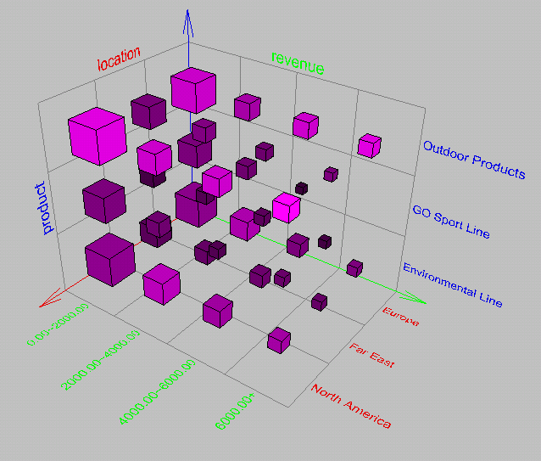
View of Warehouses and Hierarchies
Visualization
OLAP capabilities
Interactive manipulation

Slide 25
Typical OLAP Operations
Roll up (drill-up): summarize data
by climbing up hierarchy or by dimension reduction
Drill down (roll down): reverse of roll-up
from higher level summary to lower level summary or detailed data, or introducing new dimensions
Slice and dice: project and select on one or more dimensions
Pivot (rotate):
reorient the cube, visualization, 3D to series of 2D planes
Other operations
drill across: involving (across) more than one fact table
drill through: through the bottom level of the cube to its back-end relational tables (using SQL)

Slide 26
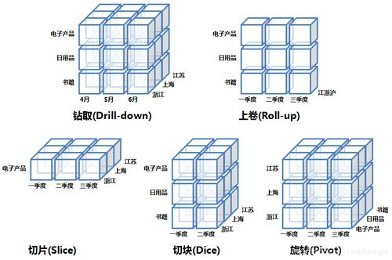
Typical OLAP Operations

Slide 27
Typical OLAP Operations (1)
Roll up 上卷 (drill-up上钻): summarize data
by climbing up hierarchy (dimension reduction)
Canada
USA
605
Q1
1181
Q2
Vancouver
Q3
New York
605
roll-up on location
from cities to countries
Q4
Chicago
471
Q1
710 820 402
TV CD PC
Q2
Q3
Q4
TV CD PC

Slide 28
Typical OLAP Operations(2)
Roll down下卷 (Drill down下钻): reverse of roll-up
from higher level summary to lower level summary or detailed data, or introducing new dimensions
Vancouver
New York
Chicago
102
Jan
Vancouver
605
Feb
150
New York
471
Mar
150
Chicago
Apr
Q1
710 820 402
Q2
May
Q3
Jun
drill-down on time
from quarters to months
Q4
Jul
TV CD PC
Aug
Sep
Oct
Nov
Dec
TV CD PC

Slide 29
Typical OLAP Operations(3)
Slice(切片) and dice(切块):
project and select
New York
Chicago
471
Q1
710
Q2
TV CD
Vancouver
Dice for location=(“Chicago”
or “New York” ) and
(time=“Q1” or “Q2”)
and ( item =“TV” or “CD”)
New York
605
Chicago
471
Q1
710 820 402
Q2
Q3
Q4
Vancouver
TV CD PC
New York
Slice for time =“Q1”
Chicago
710 820 402
TV CD PC

Slide 30
Typical OLAP Operations (4)
Pivot 旋转 (rotate旋转):
reorient the cube, visualization, 3D to series of 2D planes.
Other operations
drill across: involving (across) more than one fact table
drill through: through the bottom level of the cube to its back-end relational tables (using SQL)
Vancouver
TV
710
Location(cities)
New York
Pivot
CD
820
Chicago
710 820 402
PC
402
TV CD PC
Vancouver
Chicago
Item(types)
New York

Slide 31
A Star-Net Query Model
Customer Orders
Shipping Method
Customer
CONTRACTS
AIR-EXPRESS
ORDER
TRUCK
PRODUCT LINE
Time
Product
ANNUALY
QTRLY
DAILY
PRODUCT ITEM
PRODUCT GROUP
CITY
SALES PERSON
COUNTRY
DISTRICT
REGION
DIVISION
Location
Promotion
Organization
Each circle is called a footprint.

Slide 32
Thanks！
Notes:
工作新意图发现

